Slide 1
Ulwazi mayelana nokumelana (ukungasebenzi) nemishanguzo yesandulela ngculaza

Slide 2
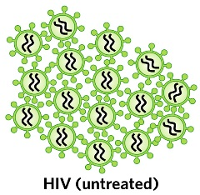
Kuyini ukumelelana (ukungasebenzi) nemishanguzo yesandulela ngculaza?
Ngesikhathi umuntu etheleleka ngesandulela ngculaza, ingciwane lingena emzimbeni womuntu bese liqala lenza imifanekiso yalo.

Slide 3
Kuyini ukumelelana (ukungasebenzi) nemishanguzo yesandulela ngculaza?
Imithi esetshenziswa ukudambisa isandulela ngculaza ibizwa ngama antiretrovirals (ARVs).
Notes:
Ukuthatha ama-ARVs ngendlela kuvame ukusho ukuthatha izihlobo ezi – 3 ezahlukene, ngoba kuthatha ngaphezulu kohlobo olulodwa lwama – ARV kunqanda isandulela ngculaza ekwenzeni imifanekiso yalo.

Slide 4
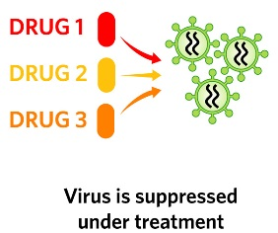
Kuyini ukumelelana (ukungasebenzi) nemishanguzo yesandulela ngculaza?
Uma ethathwa ngendlela okufanele athathwe ngayo, ama, ama- ARV avimbela ingciwane ekwenzeni imifanekiso yalo futhi isiza abantu abaphila nasandulelangculaza bezizwe bengcono baphinde bephile sikhathi eside.

Slide 5
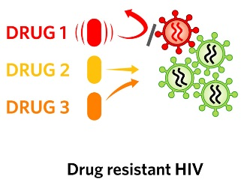
Nabuba kunjalo, ama-ARV kwesinye iskhathi awasebenzi ngokuphelele, futhi kwesinye Isikhathi ayahluleka ukuvimba igciwane ukwenza imifanekiso yalo.
Kuyini ukumelelana (ukungasebenzi) nemishanguzo yesandulela ngculaza?

Slide 6
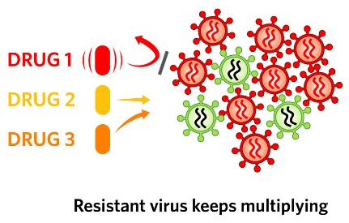
Ngesikhathi kwenzeka lokhu, uma lokhu kwenzeka, isandulela ngculaza siyakwazi ukuqhubeka nokwenza imifanekiso yaso lokhu kubizwa ngo “kumelana” (nemishaanguzo)
Kuyini ukumelelana (ukungasebenzi) nemishanguzo yesandulela ngculaza?

Slide 7
Kungani ukumelana nemithi yama – ARV kuyinkinga?
Uma ukumelana (ukunqaba ukusebenza) kwenzeka, kuyekudingeke umuntu ame ukusebenzisa uhlobo lwama –ARV angasasebenzi futhi aqale ukuthatha uhlobo oluhlukile lwama ARV.

Slide 8
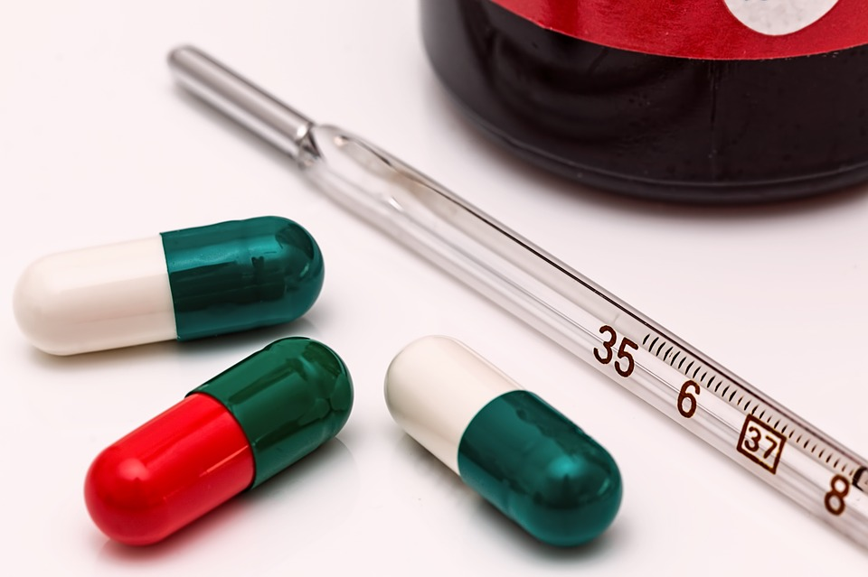
Kungani ukumelana nemithi yama – ARV kuyinkinga?
Ngenxa yalokhu, umuntu onesandulela ngculaza esimelana nemishanguzo unamathuba ambalwa okuzikhethela kwimithi yama ARV angamsiza ukuthi ahlale ephilile.
Ngaphezu kwalokho bangathelela abanye ngegciwane elinokumelana nalemshanguzo.

Slide 9
Kungani kunokukhathazeka nokumelana nama ARV ocwaningweni?
Iringi yesitho sangasese besifazane iqukethe i-ARV ebizwa nge – Depivarine. I-Dipiririne isetshenziswa kuphela njengesivikeli sesandulela ngculaza, futhi ayisetshenziselwa ukulapha (ukudambisa) abantu asebetheleleke ngesandulela ngculaza.

Slide 10
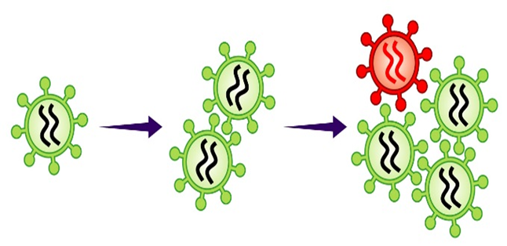
Kungani kunokukhathazeka nokumelana nama ARV ocwaningweni?
Uma owesifazane etheleleka ngesandulela ngculaza futhi eqhubeka nokusebenzisa iringi, igciwane elisemzimbeni wakhe kungenzeka limelane nedipivarine kanye neminye imithi yama ARV efanayo esetshenziswa ukudambisa (ukwelapha) isandulela ngculaza noma ukuvikela ukudliliselwa kwesandulela ngculaza wumama okhulelwe kumntwana ongakazalwa.

Slide 11
Kungagwenywa kanjani ukumelana nemishanguzo yama-ARV ngesikhathi ubambe iqhaza kuHOPE?
1. Gwema ukuthola isandulela ngculaza:
Ukumelana nama – ARV akukwazi ukwenzeka kumuntu ongenaso isandulela ngculaza.
Notes:
Zimingi izinto ongazenza ukunciphisa incuphe yesandulela ngculaza:

Slide 12
Kungagwenywa kanjani ukumelana nemishanguzo yama-ARV ngesikhathi ubambe iqhaza kuHOPE?
Sebenzisa iring yesitho sangasese yabesifazane ngaso sonke Isikhathi.
Sebenzisa amakhondomu ngasosonke Isikhathi.

Slide 13
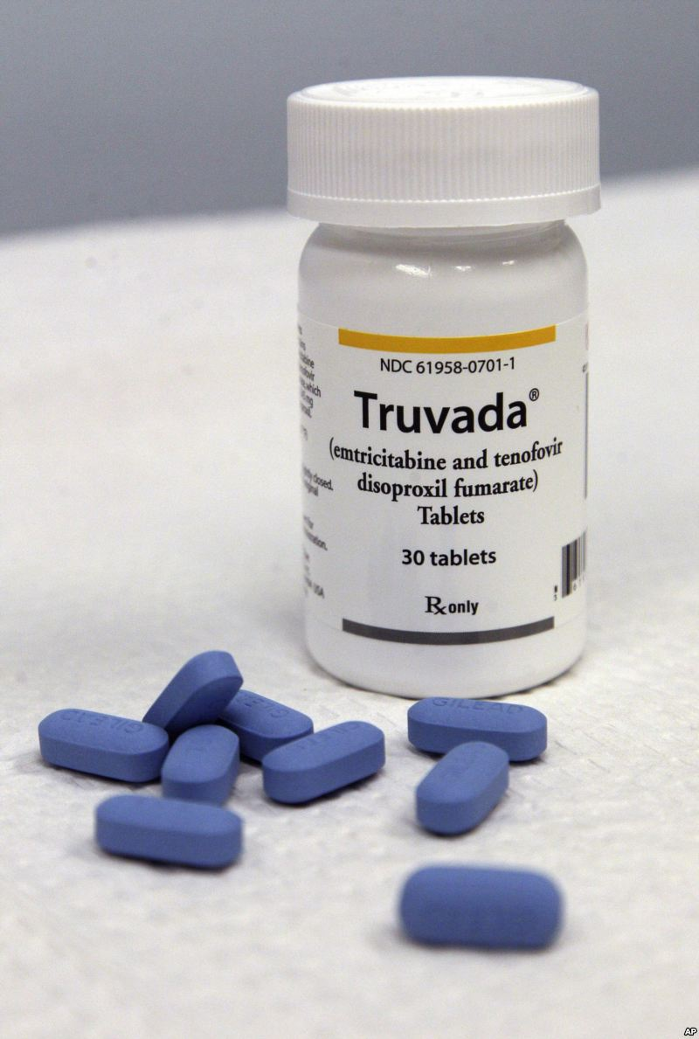
Kungagwenywa kanjani ukumelana nemishanguzo yama-ARV ngesikhathi ubambe iqhaza kuHOPE?
Sebenzisa iPrEP (ukusetshenziswa kwama – ARV ukuvikela ukutheleleka ngesandulela ngculaza) (isibonelo. Truvada)
Nciphisa isibalo sophathini oya nabo ocansini.
Zibandakanye emikhubeni yocansi enengcuphe encane.

Slide 14
Kungagwenywa kanjani ukumelana nemishanguzo yama-ARV ngesikhathi ubambe iqhaza kuHOPE?
Uma unesifo esithathelana ngokocansi, thola ukwelashwa.
Gqugquzela uphathina wakho ukuhlolela isandulela ngculaza.
Uma uphathina wakho esethelelekile ngesandulela ngculaza, mqguqguzele ukuthatha ama – ARV ngendlela efanele.
Notes:
Buza umeluleki wakho mayelana ngencwajana “enolwazi ngezinto zokuvikela” ngolunye ulwazi olwengeziwe ngalezizindlela.

Slide 15
Kungagwenywa kanjani ukumelana nemishanguzo yama-ARV ngesikhathi ubambe iqhaza kuHOPE?
2. Hlolela isandulela ngculaza njalo:
Ukuhlolelwa isandulela ngculaza kuyokwenziwa kukho konke ukuvakasha kwasocwaningweni.
Yiza esikhungweni socwaningo ukuzohlolela isandulela ngculaza uma ucabanga ukuthi usutheleleke ngesandulela ngculaza phakathi kokuvakasha kwakho ocwaningweni.

Slide 16
Kungagwenywa kanjani ukumelana nemishanguzo yama-ARV ngesikhathi ubambe iqhaza kuHOPE?
Uma imiphumela yokuhlolwa kwakho iveza ukuthi usunesandulela ngculaza, kubalulekile ukuthi uthi uyeke ukusebenzisa iringi yestho sangasese yabesifazane ngaso leso sikhathi ukusiza ukuvimbela ukungazweli kwemishanguzo yesandulela ngculaza.
Notes:
Uma umbambiqhaza eqiwe ukuvakasha kwasocwaningweni okuhleliwe, kungenzeka atheleleke ngesandulela ngculaza, engenalwazi lwalokhu, aqhubeke asebenzisese iringi yesitho sangasese yabesifazane. Lokhu kungaholela egciwaneni elimelana yesandulela ngculaza.

Slide 17
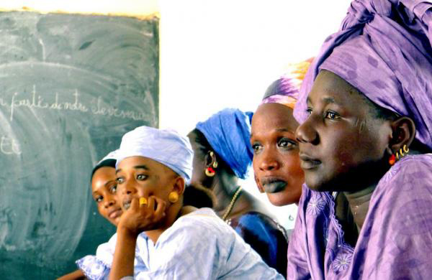
Kungagwenywa kanjani ukumelana nemishanguzo yama-ARV ngesikhathi ubambe iqhaza kuHOPE?
3. Ungabelani ngeringi yesitho sangasese yabesifazane:
Ababambiqhaza ocwaningweni bathola ukuhlolwa ngekwezempilo nesandulela ngculaza.
Abantu abangeyona Ingxenye yocwaningo abakutholi lokhu kuhlolwa ngokwezempilo. Lababantu kungenzeka ukuthi sebethelelekile ngesandulela ngculaza, kodwa bengazi.
Notes:
Uma abantu asebethelelekile ngesandulela ngculaza besebenzisa iringi yesitho sangasese yabesifazane, lokhu kungabangela ukumelana nokusebenza kweminye imithi yama ARV.

Slide 18
Uma unemibuzo noma udinga ulwazi olwengeziwe, sicela uvakashele eklinikhi yocwaningo.
Abasebenzi bocwaningo bakhonela ukukusiza
Notes:
Abasebenzi bocwaningo bakhonela ukukusiza.
Abasebenzi bocwaningo bakhona ukukwazisa nokweluleka ababambiqhaza ocwaningweni, ophathina babo, kanye namanye amalungu omphakathi mayelana nokumelana nemishanguzo yama-ARV kanye nanoma imiphi imibuzo noma ukukhathazeka abangase babe nakho.

